Slide 1
DEPLOYED AN APP ON STREAMLIT
Step by step

Slide 2
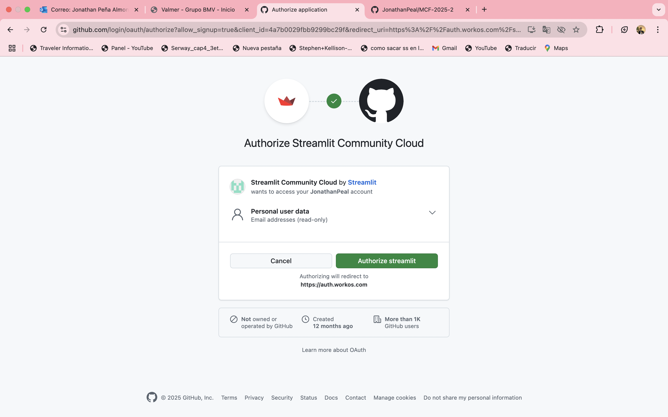

Slide 3
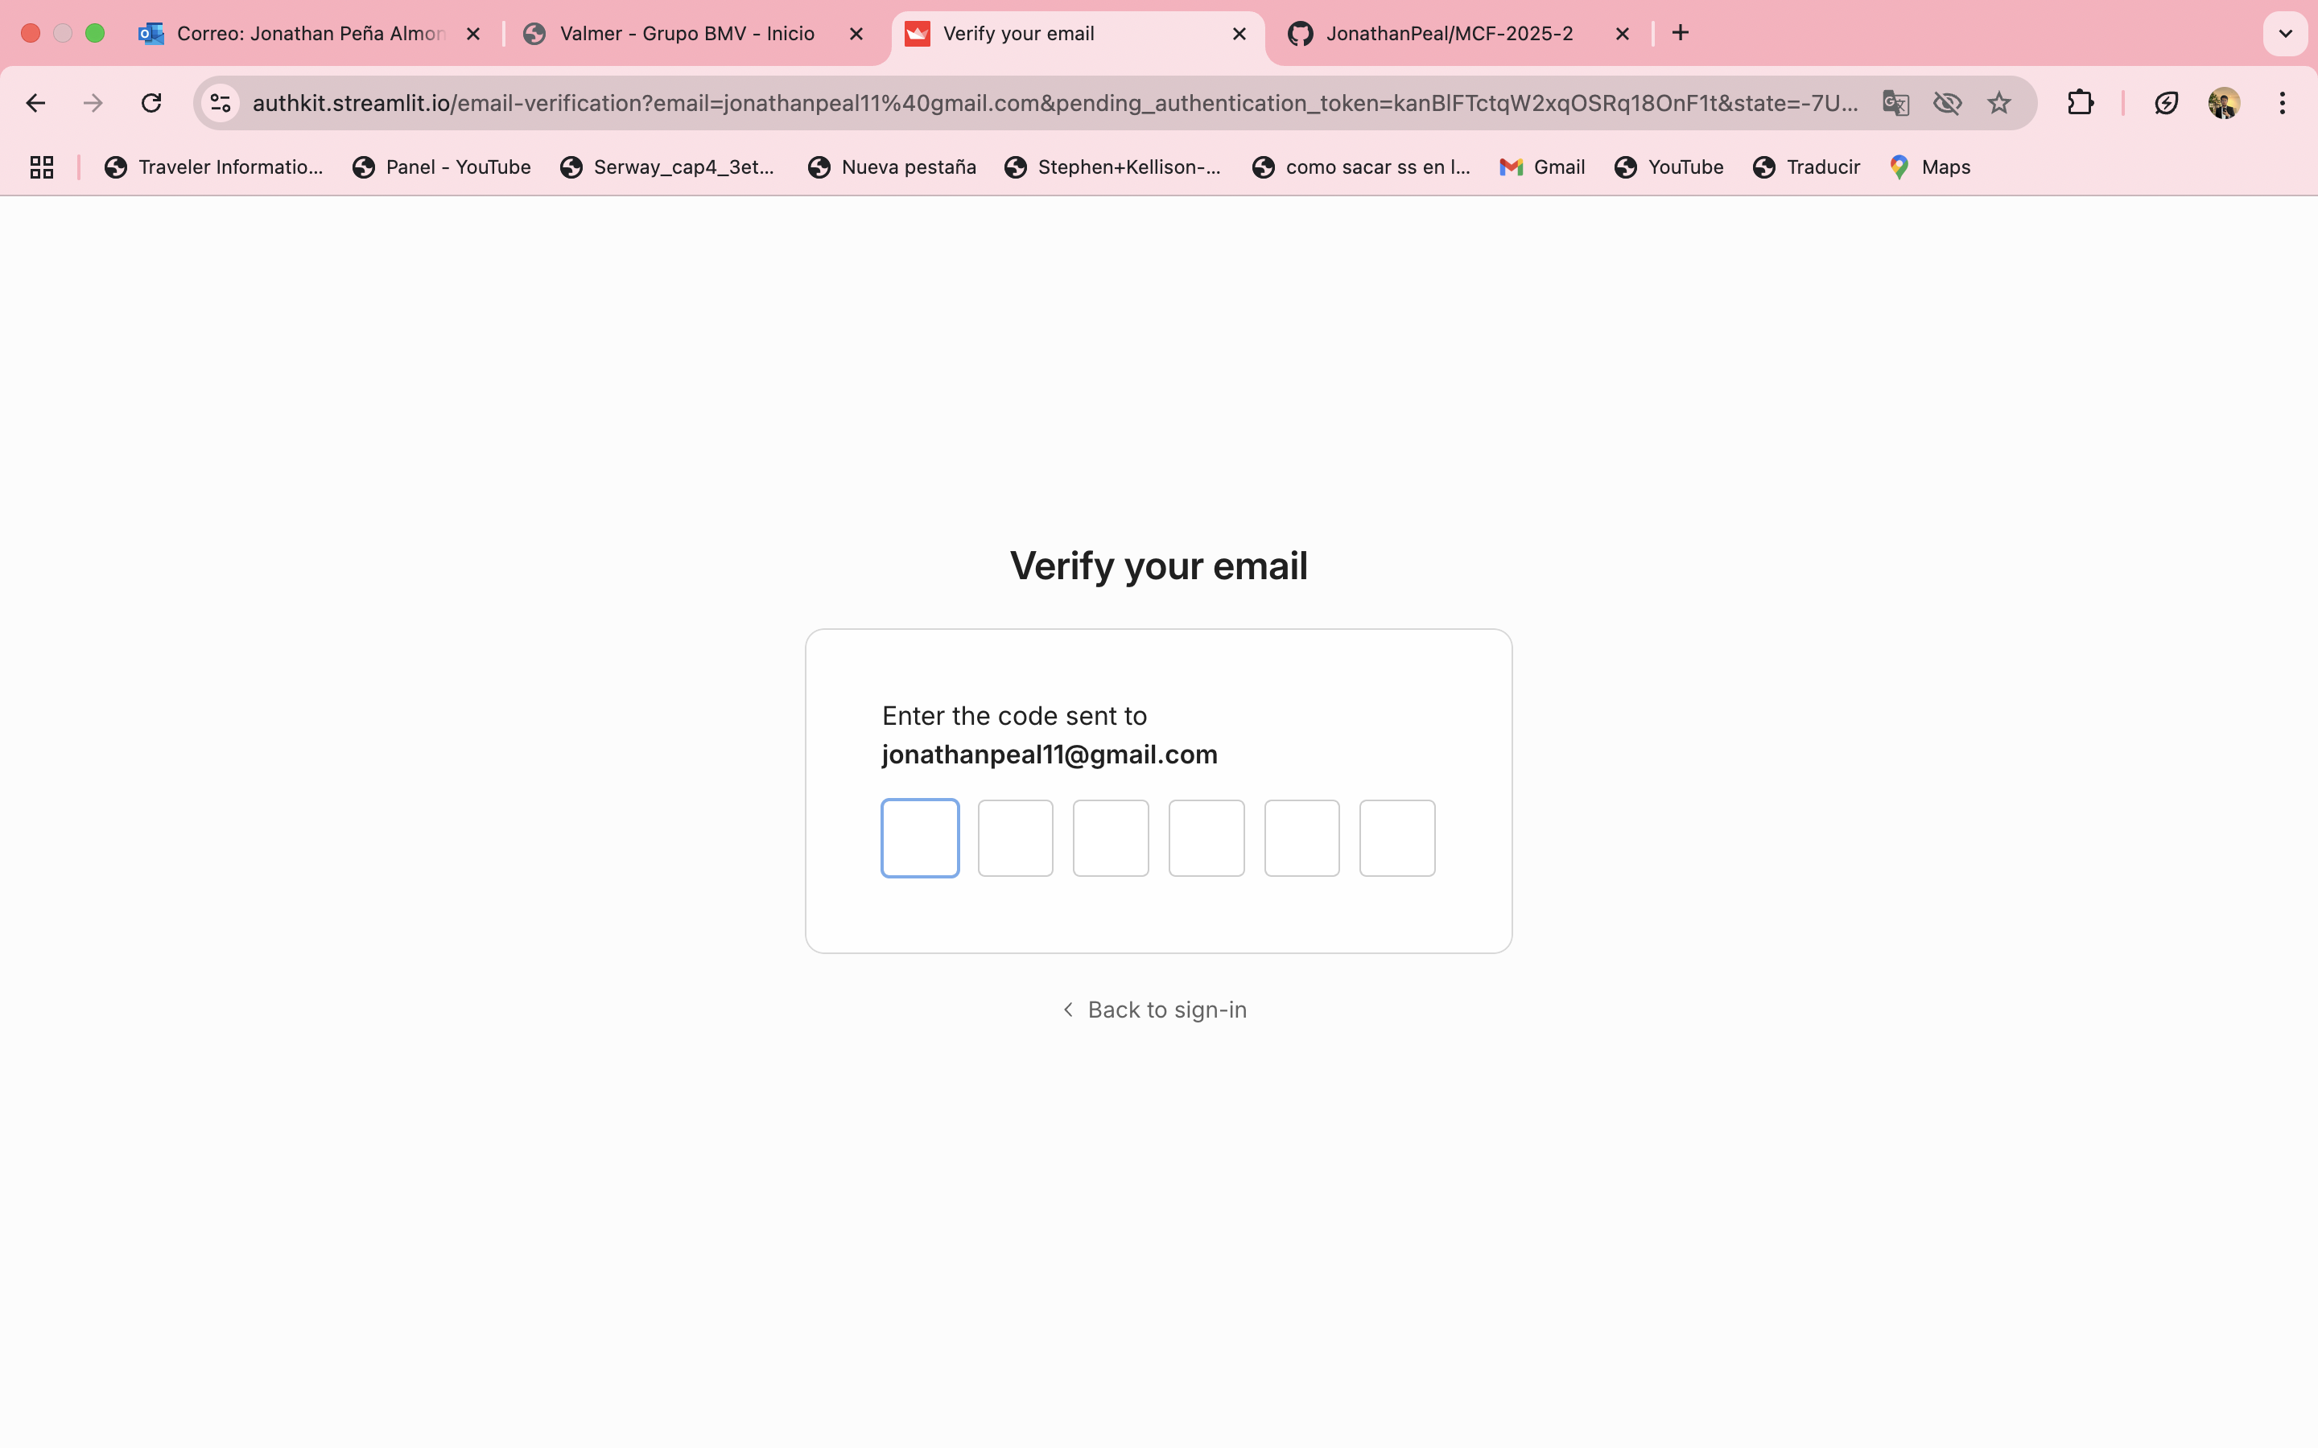

Slide 4
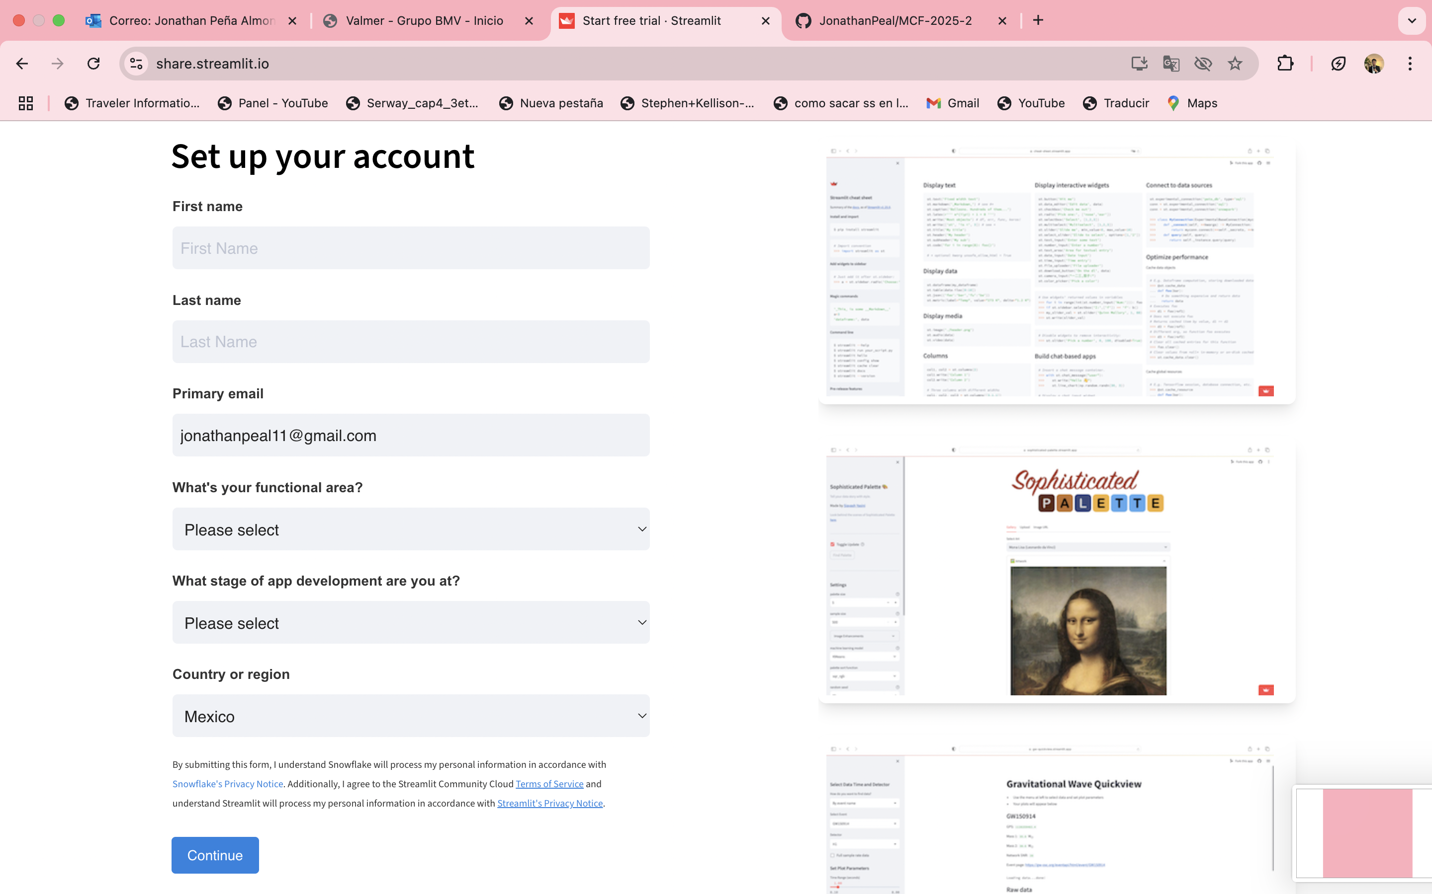

Slide 5
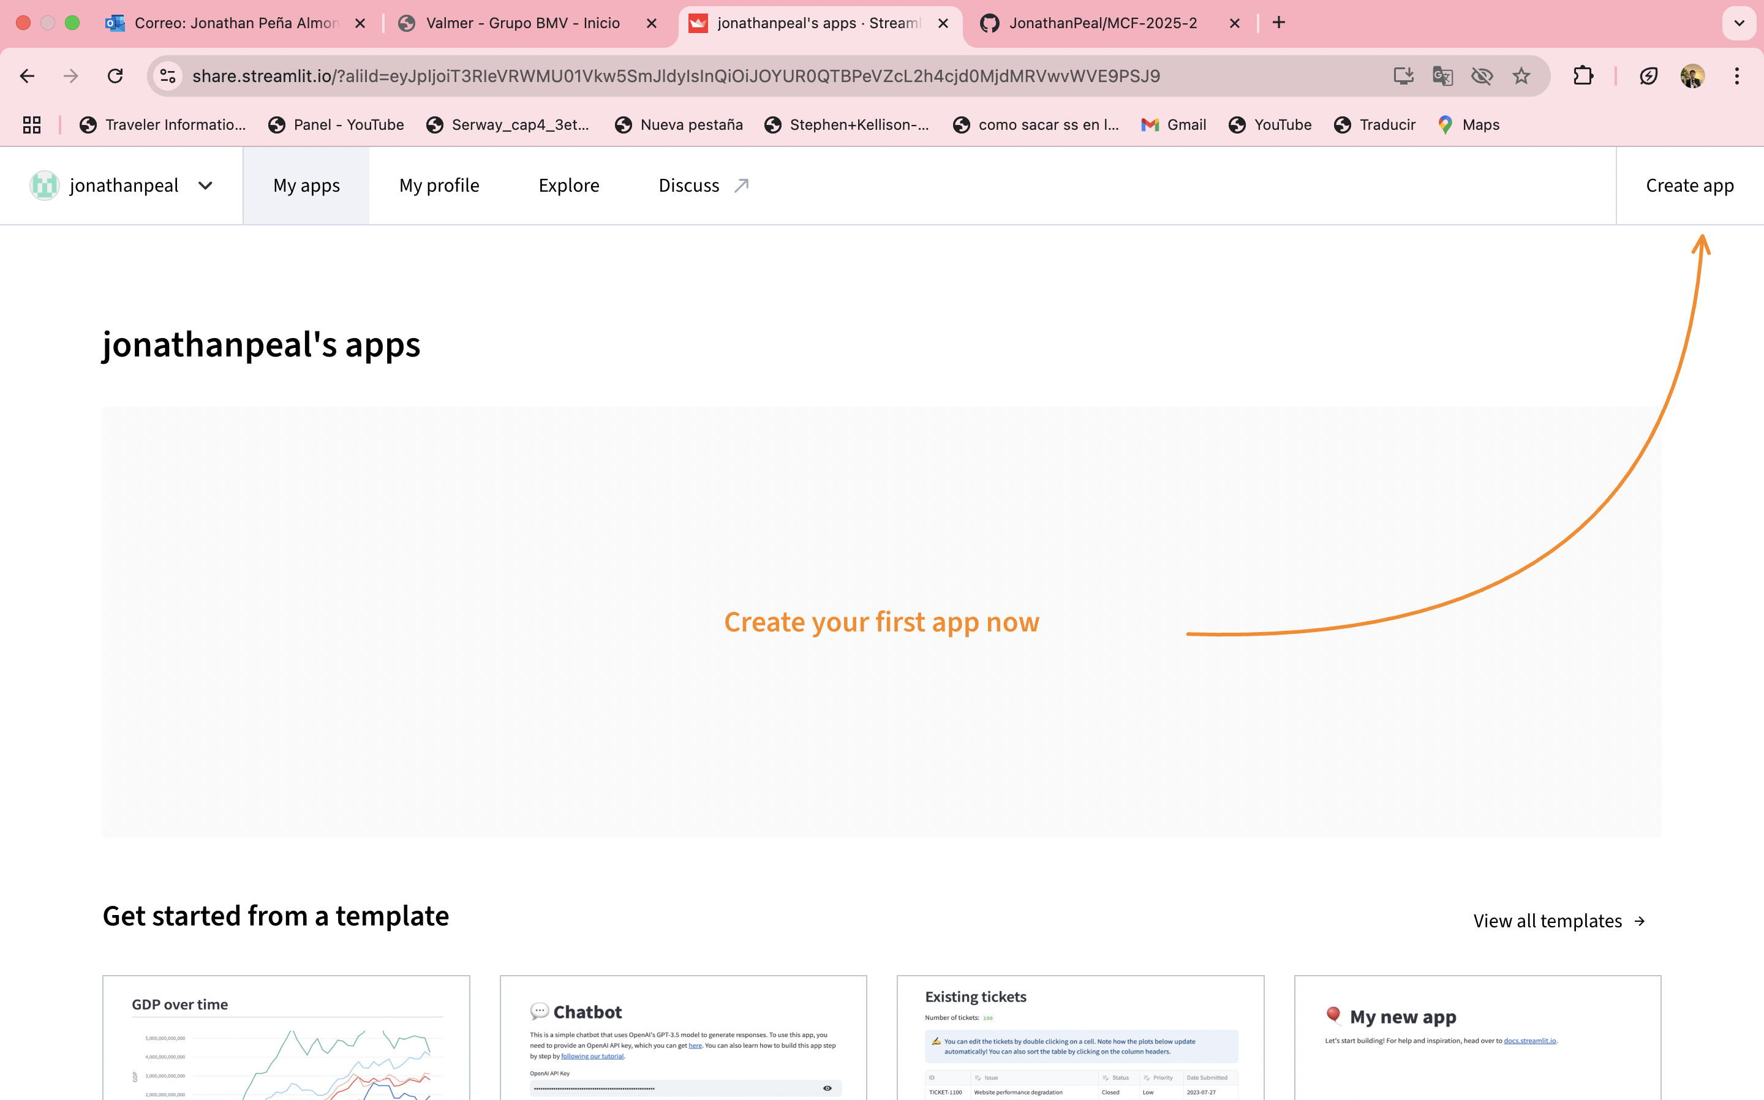

Slide 6
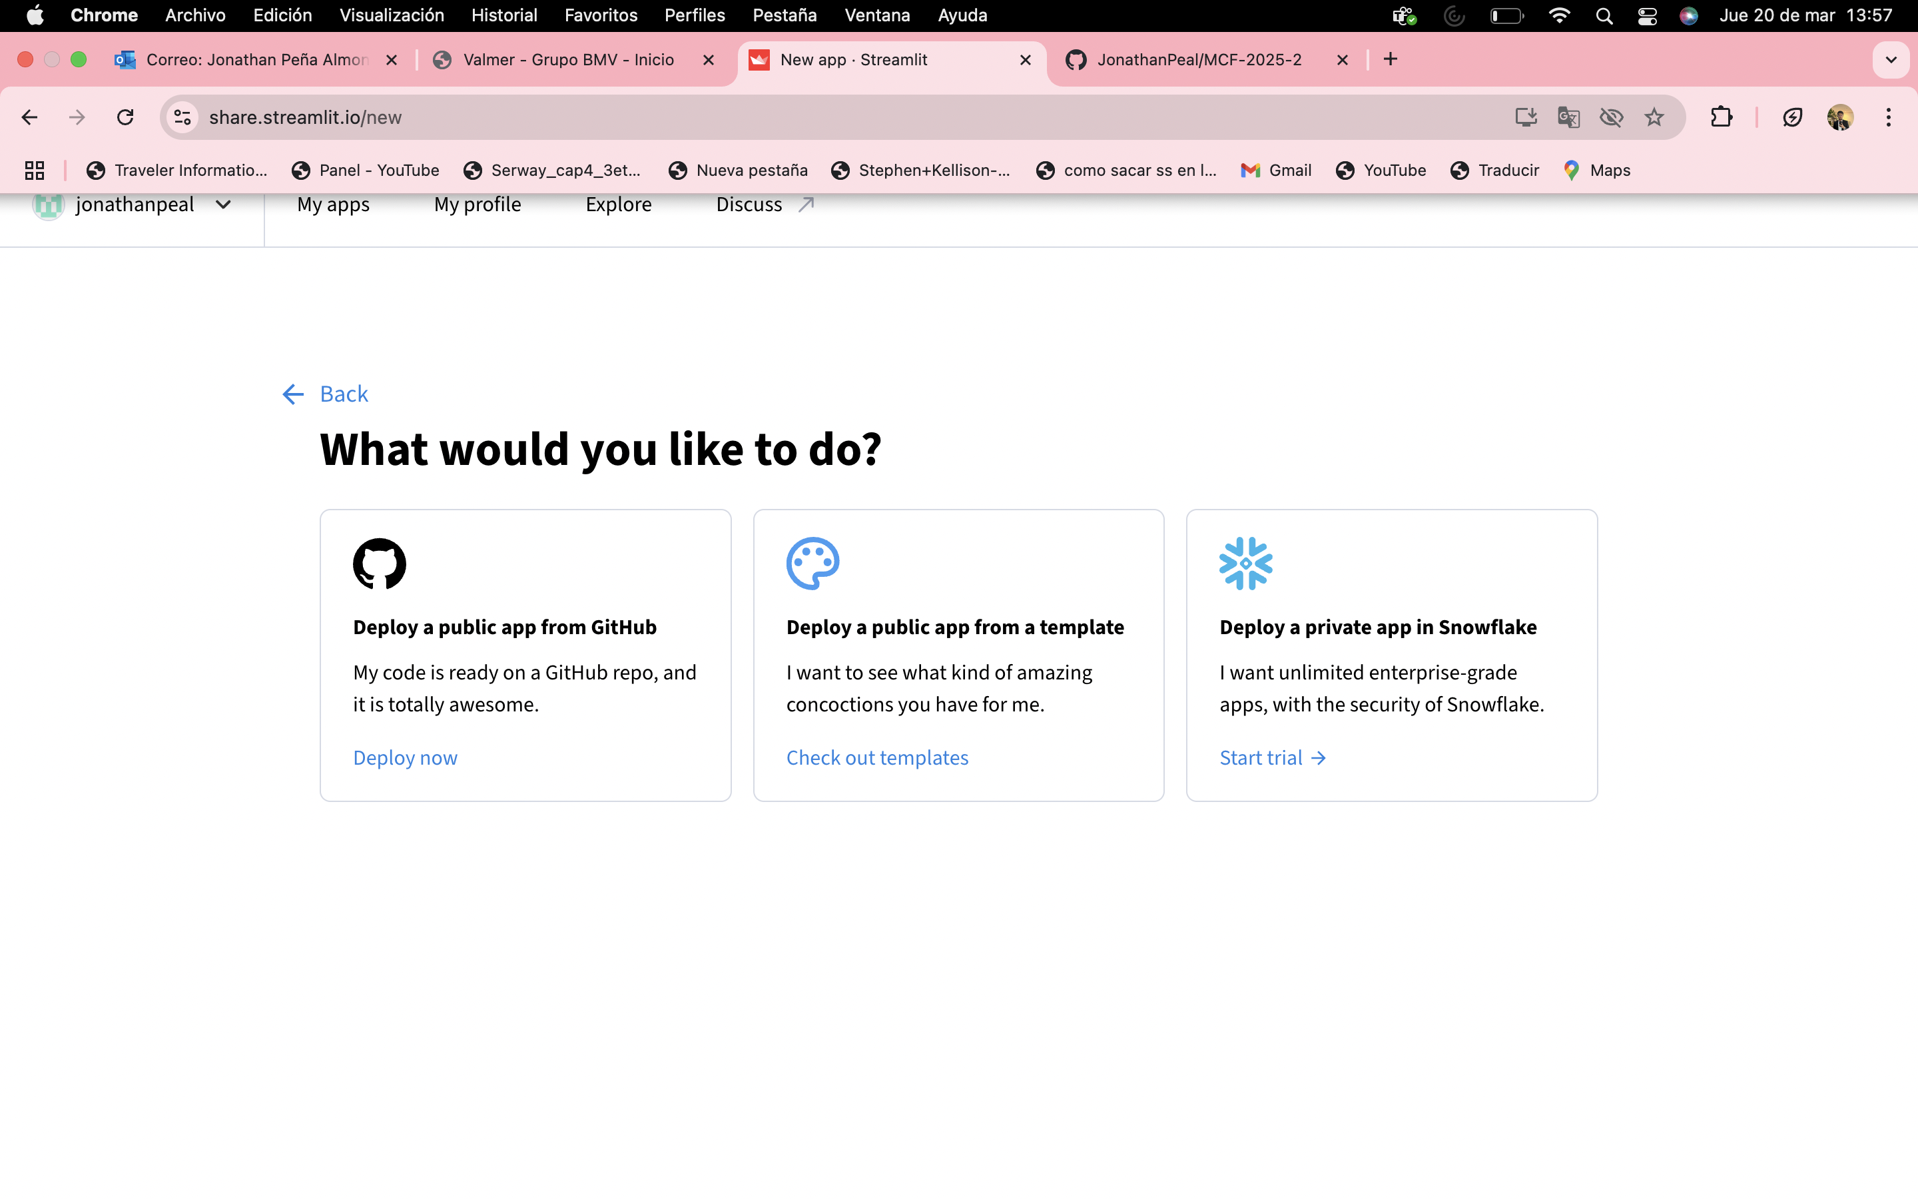

Slide 7
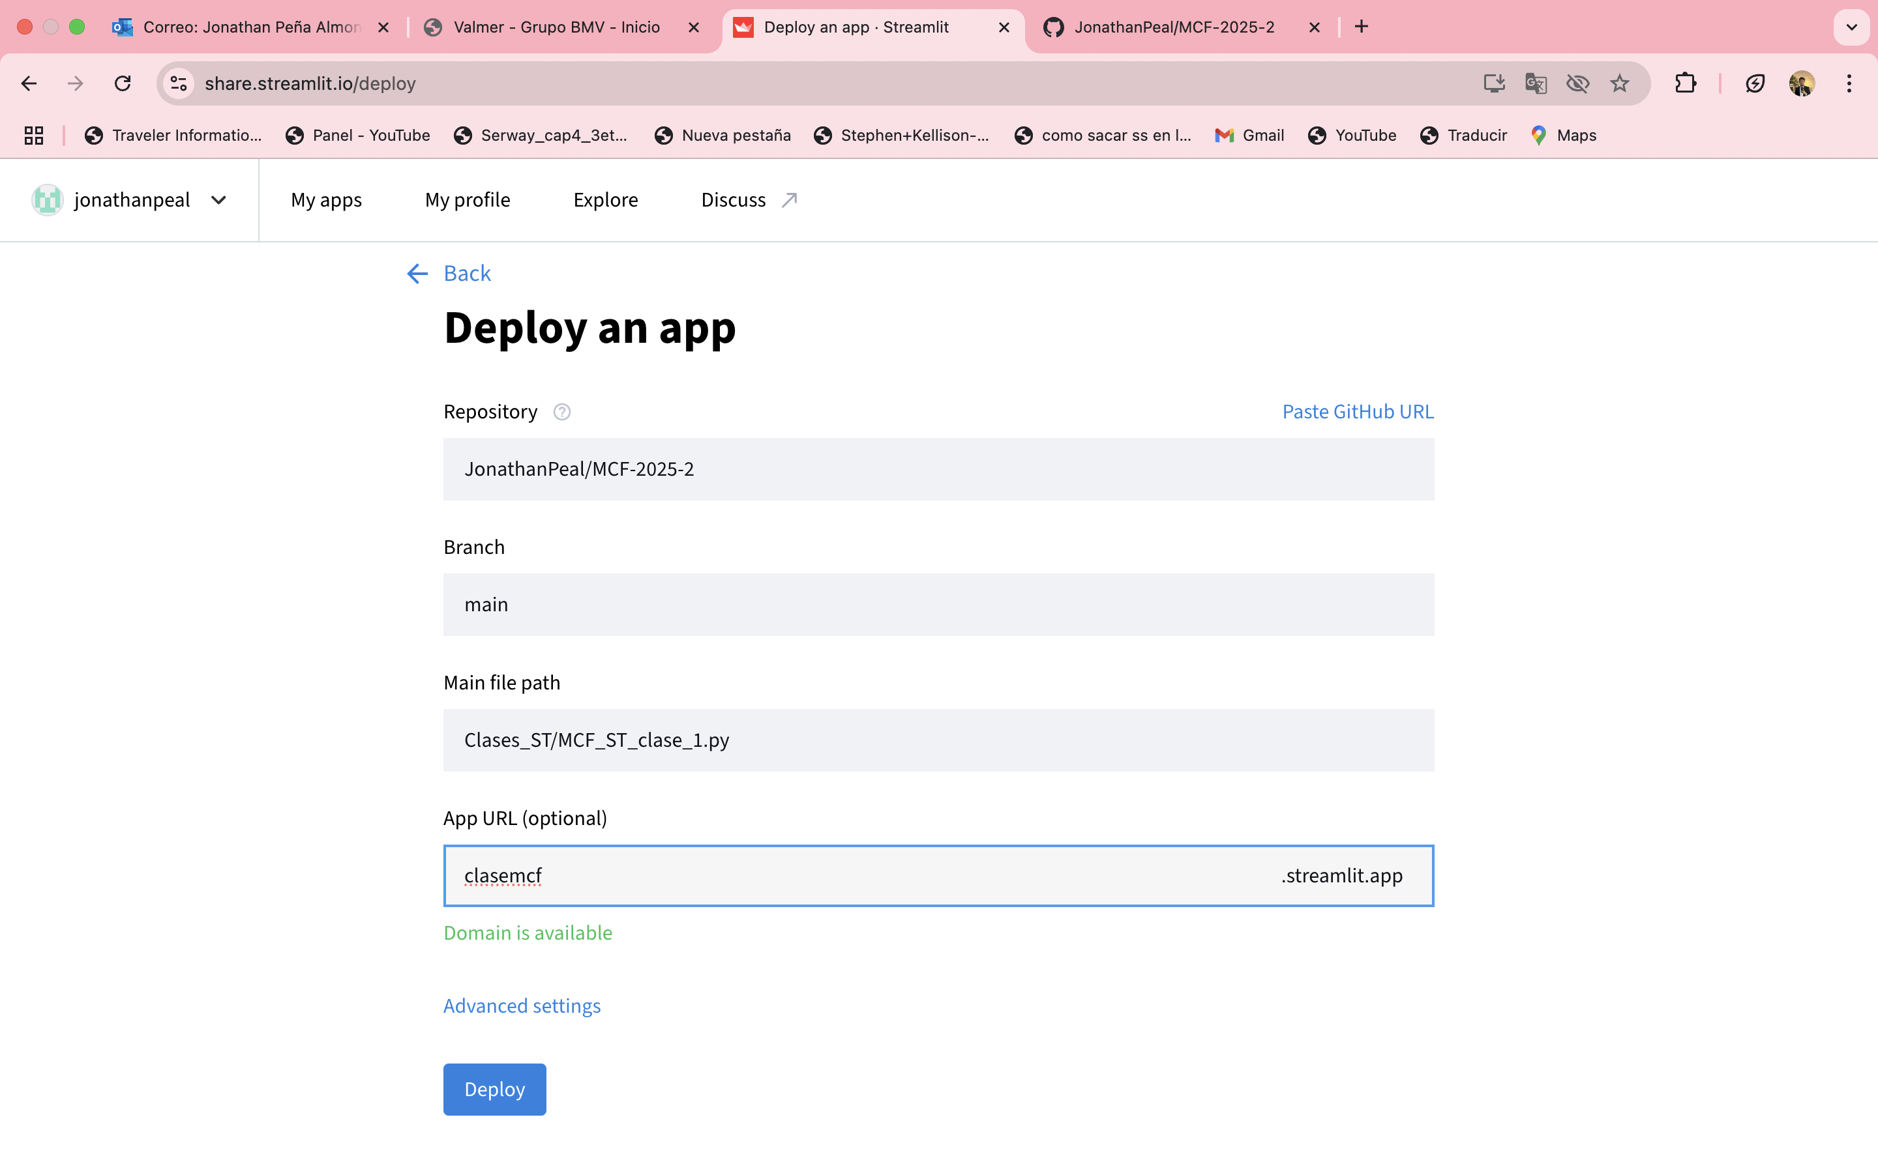

Slide 8
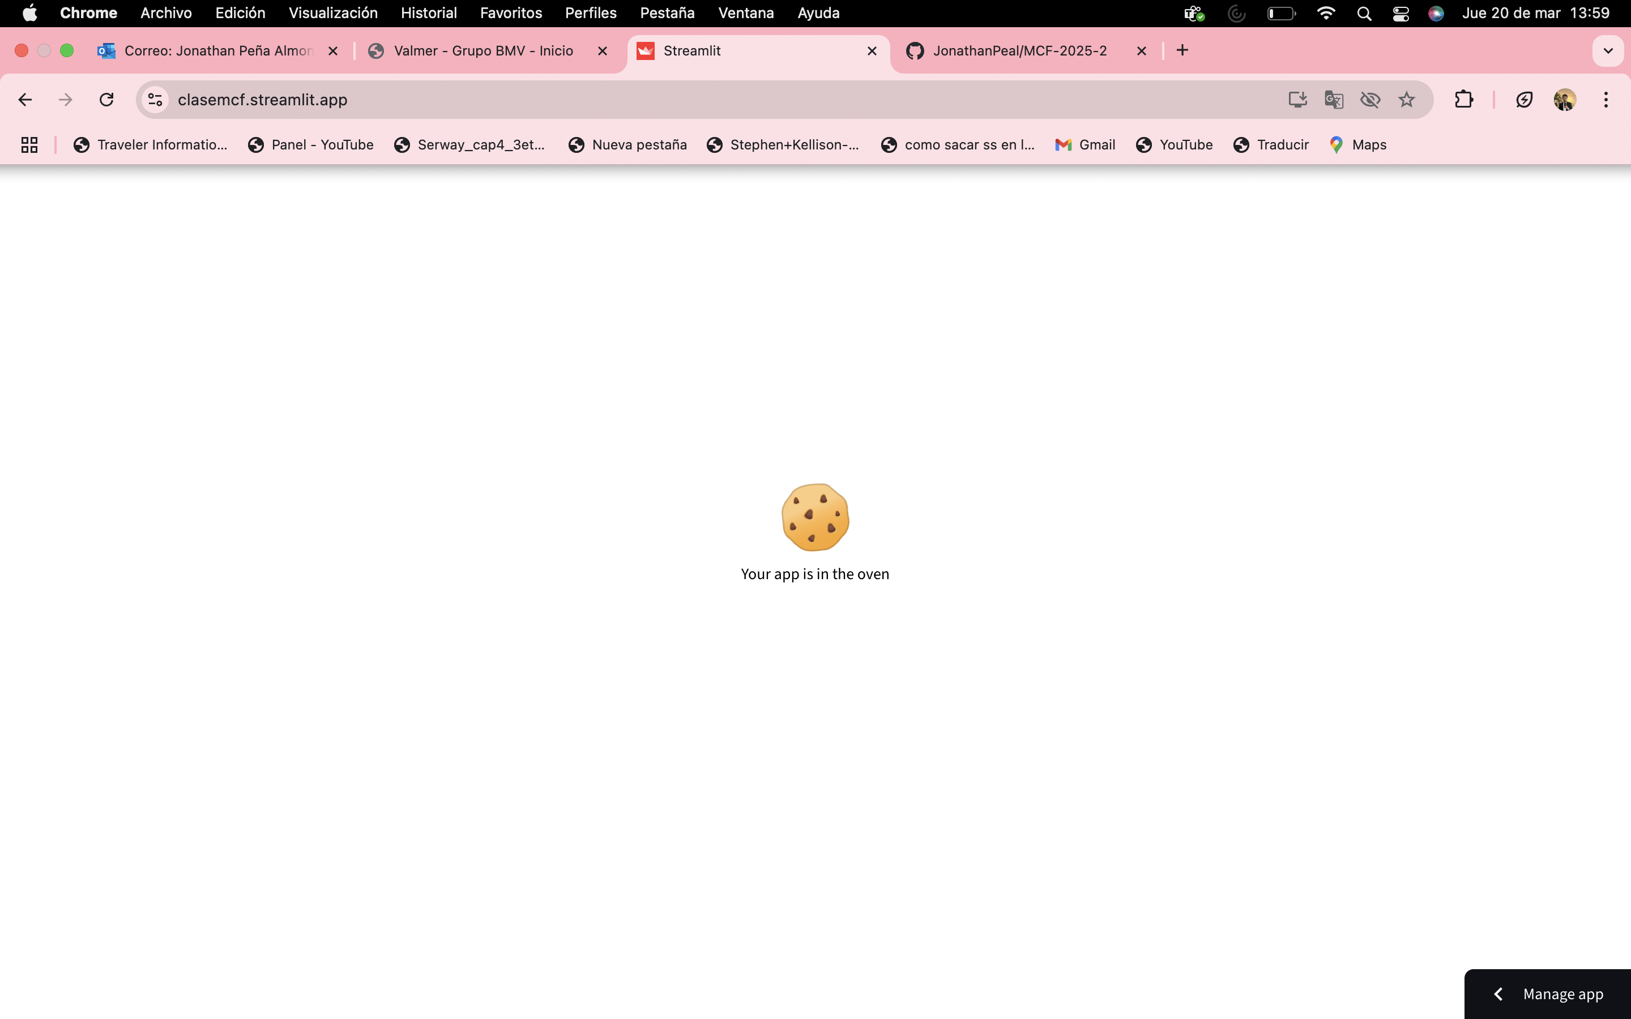

Slide 9
¿ Y la App ?
https://clasemcf.streamlit.app/

